Slide 1
Farm Management Consulting
MNP Canadian Agriculture Industry Outlook 2019
John Loeppky P.Ag
November 2019

Slide 2
Ag Industry Outlook – Table of Contents
Canadian Agricultural Industry Outlook 2019
  Market Fundamentals
  US Dollar – US Trade
  Poultry
  Dairy
  Crops
  Hogs
  Beef
  Wineries
  Cannabis
  Food and Beverage
Contacts
Appendices
  Our People

Slide 3
Industry Outlook 2019
The Market Fundamentals
Supply - Demand
Production
Trade
Supply Management

Slide 4
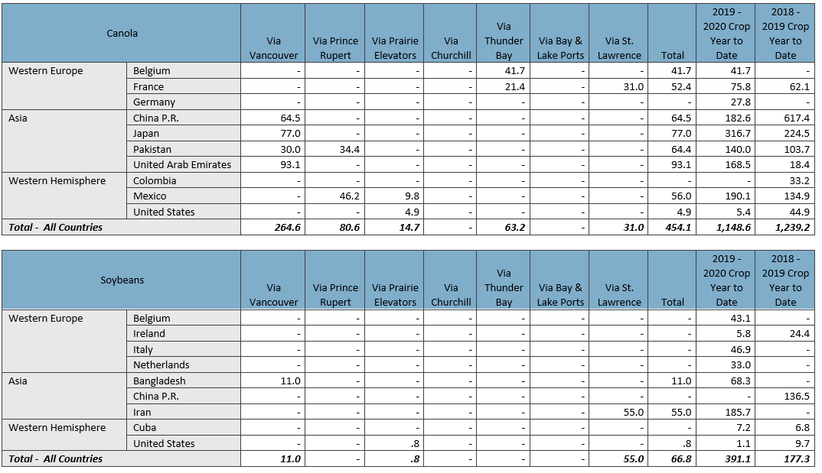
Industry Outlook 2019
Source: Canadian Grain Commission

Slide 5
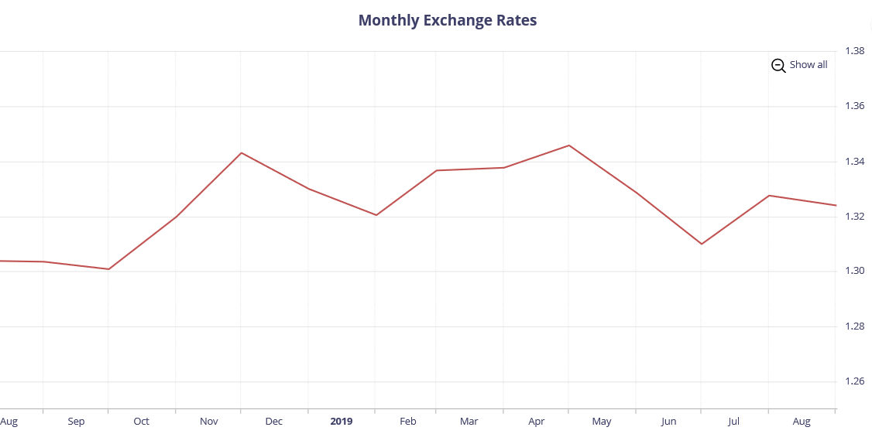
Industry Outlook 2019
Source: Bank of Canada

Slide 6
Industry Outlook 2019
Canada and China
China suspended the canola export licenses of Richardson and Viterra following the arrest of Huawei CFO Meng Wanzhou
Canada has filed a formal challenge with WTO
  Force China provide scientific evidence for suspension
China banned imports of red meat from Canada
  Falsified inspection certificates from CFIA
Made more difficult with no ambassador to China for 7 months
  Dominic Barton recently appointed
    Lots of business experience in the private sector in Asia

Slide 7
Industry Outlook 2019
Canada and Others
Saudi Arabia – Backlash for tweets by Foreign Affairs Minister
  Wheat and barley
Italy – mCOOL
  Durum
India - Protectionism
  Peas and lentils
Vietnam – “thistle seeds”
  Wheat

Slide 8
Industry Outlook 2019
USA and China
Negotiations have been going on for some time
Phase 1 deal near completion
  China agrees in principal to purchase $50 billion of US ag products within 2 years
Major stumbling block of intellectual property has not been addressed
  Can still derail everything
On-going saga
  Effecting interest rates
Ripple effects felt by Canadian farmers in commodity prices (US futures)

Slide 9
Industry Outlook 2019
USA and Japan
Gives US access to critical Asian market
  Some benefits of CPTPP without being in it
Important for US ag industry
  Pork and poultry tariffs will be eliminated over time
  Reduced mark-up on wheat and barley

Slide 10
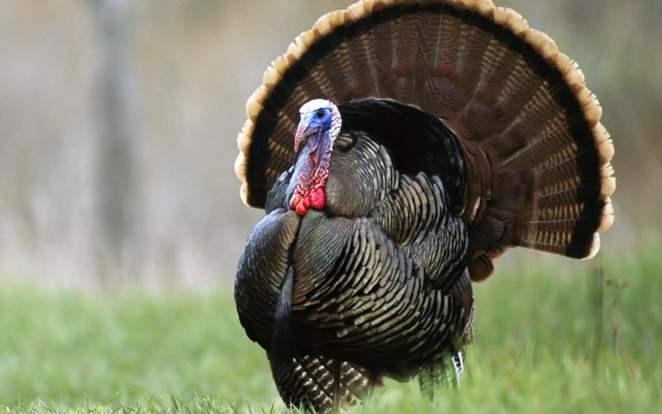
Industry Outlook 2019
Poultry
Outlook steady/good
Increasing consumer demand
Prices and consumption continue to improve
USMCA - Costco
Safe Guards
Understand the quota:
  Provincial legislation re: transferability.
  Debtor’s utilization and options to lease out quota.
  Understanding compensation rules will have bearing on security.
High land values may support security position

Slide 11
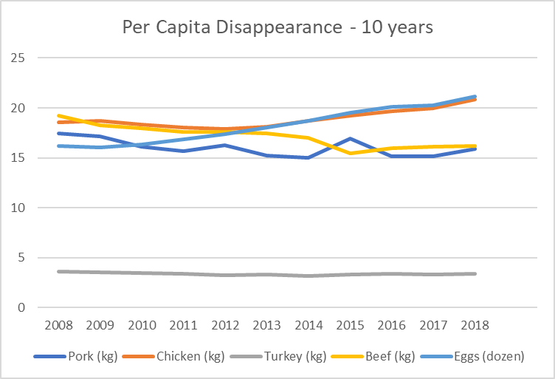
Industry Outlook 2019
Source: Statistics Canada

Slide 12
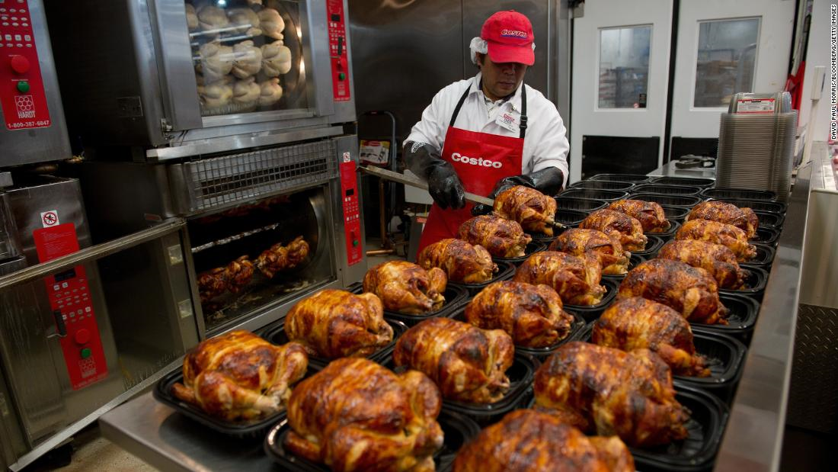
Industry Outlook 2019
Costco announces new chicken plant to supply rotisserie chicken
Currently selling 91 million per year in US
  Looking to become more vertically Integrated
US industry controlled by several large suppliers (Tyson, Pilgrim’s Pride, Sanderson Farms, Perdue, and Koch Foods control over 60% of US poultry market)

Slide 13
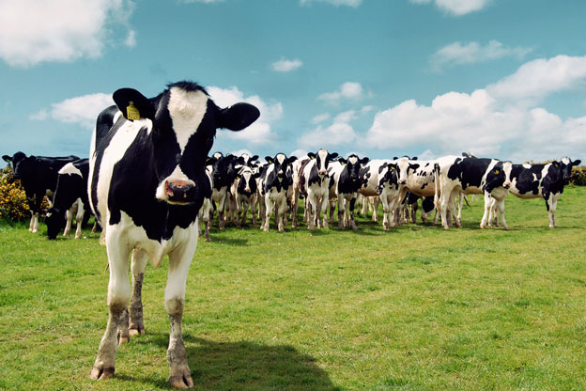
Industry Outlook 2019
Dairy
Demand for Butterfat
Quota Holdings Stable, margins tightening
Consolidation
USMCA
Safe Guards
Understand the quota:
  Provincial legislation re: transferability.
  Debtor’s utilization and options to lease out quota.
  Understanding compensation rules will have bearing on security.
High land values may support security position

Slide 14
Industry Outlook 2019
COP rose by 5.1% in 2018
Revenues expected to rise only 4.1%
Expect COP to rise again.
  Parts of country experiencing poor feed production in hay and silage which will not be offset by low feed grain prices

Slide 15
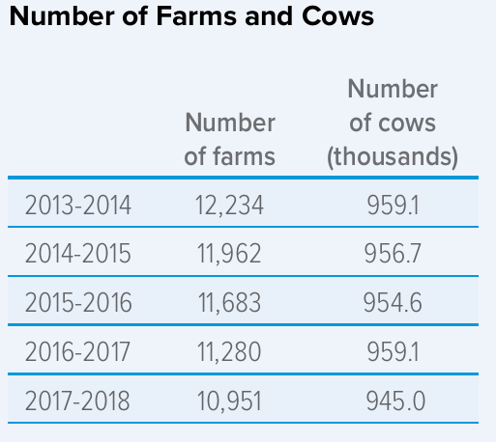
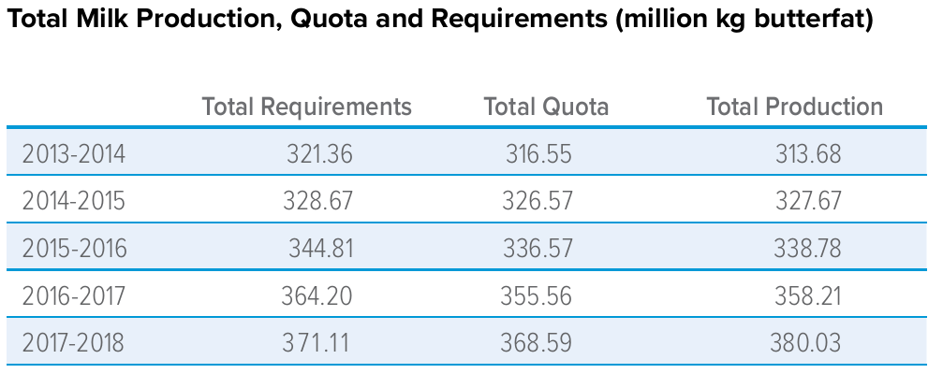
Industry Outlook 2019
Source: Canadian Dairy Commission

Slide 16
Industry Outlook 2019
Crops
Long term pricing
Production
Farm Equipment
Safe Guards
Equipment ratio on grain farms is important.
Ensure all property of creditor included on debt security
Verify proper registration on land and related farm equipment
Verify crop insurance & AgriStability status

Slide 17
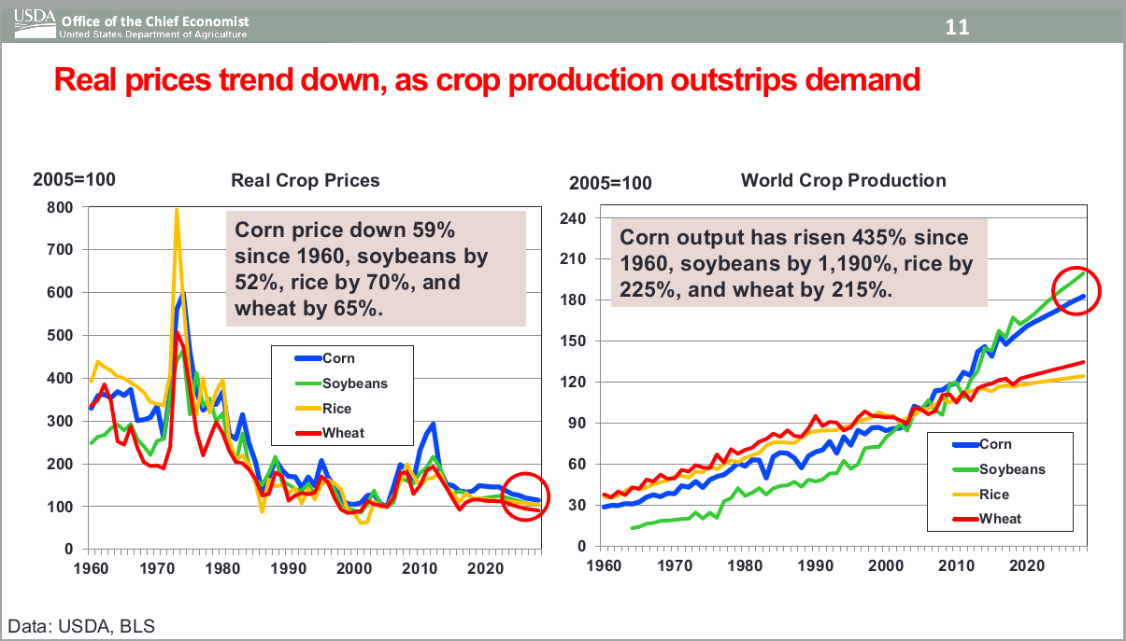
Industry Outlook 2019
Safe Guards
Equipment ratio on grain farms is important.
Ensure all property of creditor included on debt security
Verify proper registration on land and related farm equipment
Verify crop insurance & AgriStability status

Slide 18
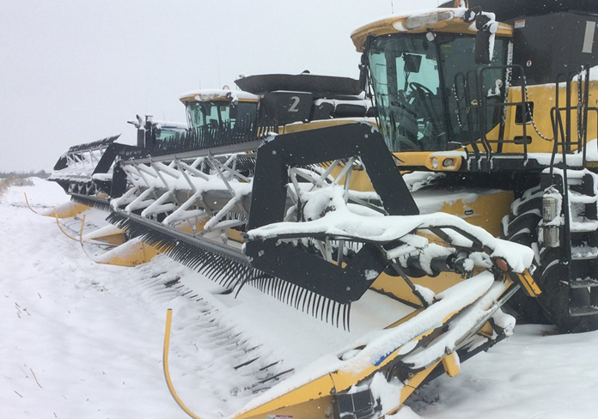
Industry Outlook 2019
Early and fast start to harvest for MB, normal for SK, delayed for AB
Weather was a major hinderance through the last half of September
  Quality will be an issue in much of AB and parts of SK
Grain movement – excellent in the new crop year
Better than expected yield’s reported so far given drought conditions
Western Canada harvest progress
  AB – 48% complete as of October 8th, 2019
  SK – 69% complete as of October 14th, 2019
  MB – 74% complete as of October 15th, 2019

Slide 19

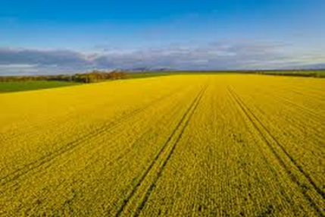
Industry Outlook 2019
Stat’s Can estimates (as of Aug 31- final report in Dec. 2019):
  Smallest soybean production in 4 years – 6.5 million tonnes
    12.5% decrease from 2018
      Acres reduced by -22%
  Second largest canola production – 19.4 million tonnes
    4.8% decrease from 2018
      Reduced acreage and drought
  Higher wheat production – 32.5 million tonnes
    0.9% increase over 2018
      Increased acres but offset by drought

Slide 20
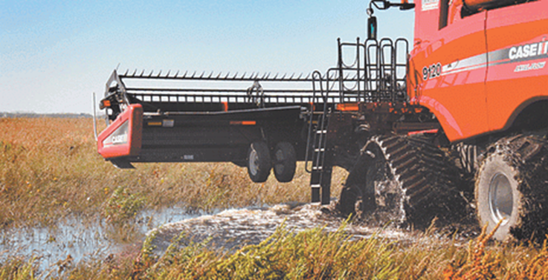
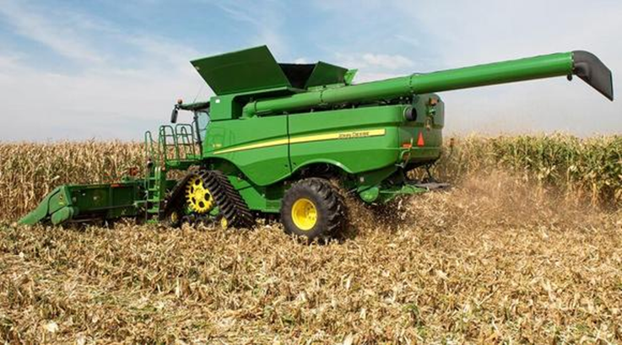
Industry Outlook 2019
Harvest has a LONG way to go
  Late seeding due to flooding/saturated fields
Can it get harvested?
  Snow and rain making it difficult
Corn: 14.4 billion bushels – 2018
  Forecasted at 13.78 billion bushels -2019
    Lower yields
Soybeans: 4.54 billion bushels – 2018
  Forecasted 3.55 billion bushels - 2019

Slide 21
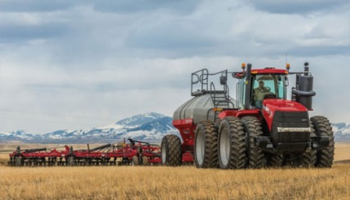
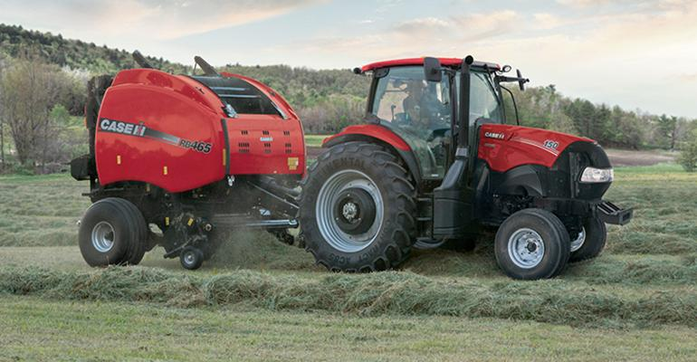
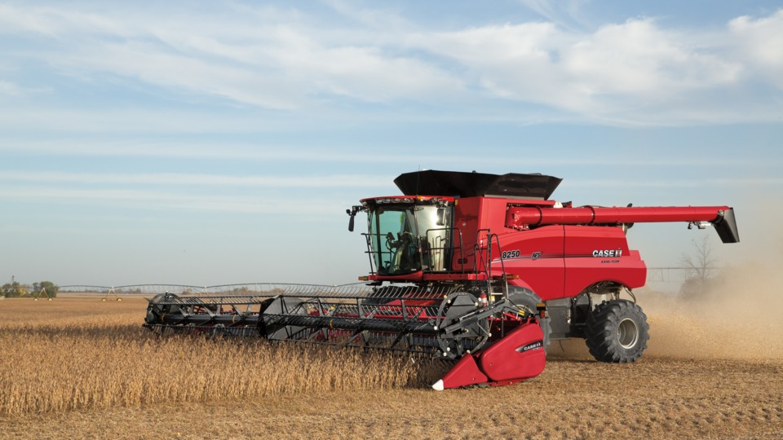
Industry Outlook 2019
Lower machinery purchases overall continue
  4WD farm tractors down -33% YOY
  >100hp tractors down -17%YOY
  Combine sales down -28% YOY

Slide 22

Industry Outlook 2019
Hogs
Projected Profitable Year
Feed costs
Trade
Disease pressure
  PEDv
  ASF
Safe Guards
Perform walk-through on short notice and assess condition of
herd and barn operations
Verify proper registration on land and related farm equipment
Verify AgriStability status.

Slide 23
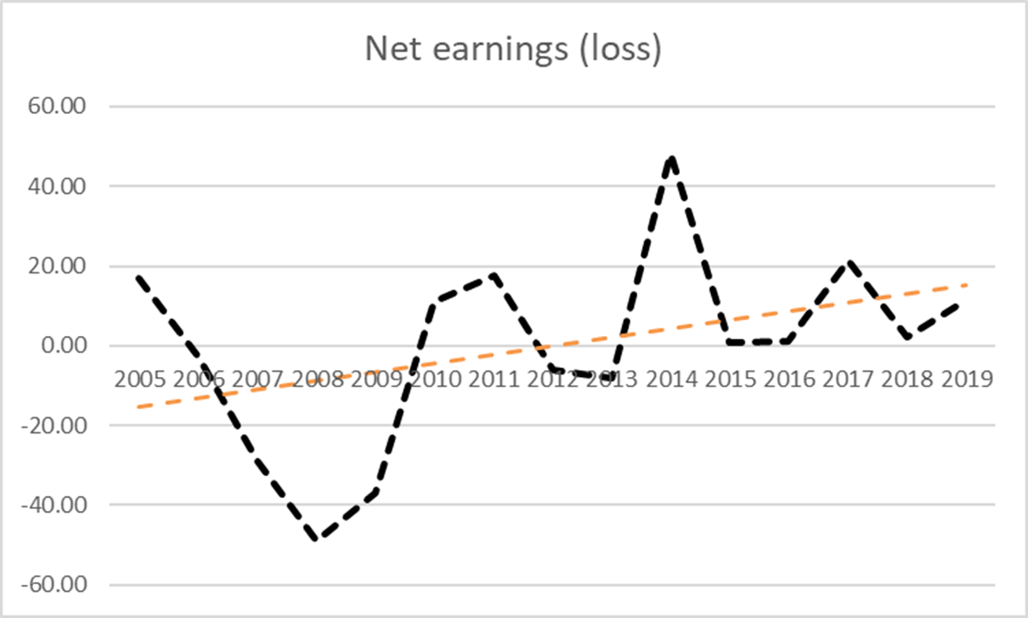
Industry Outlook 2019

Slide 24
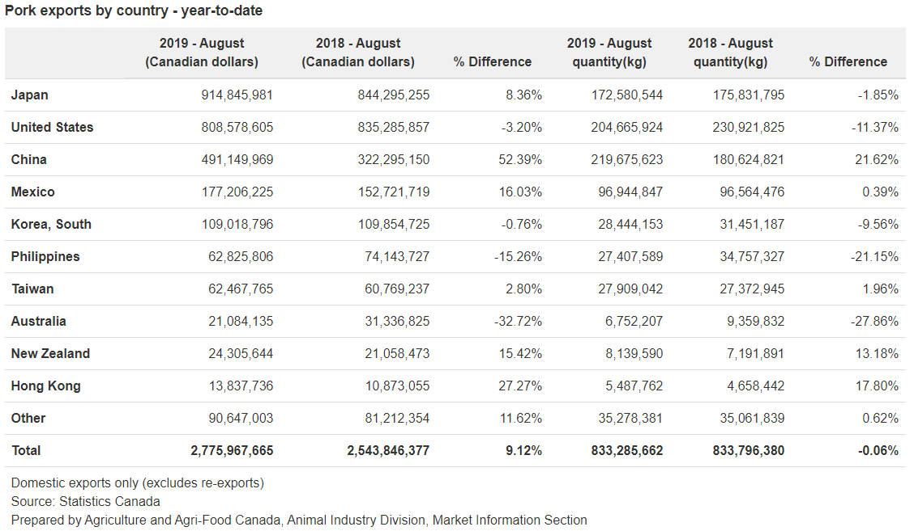
Industry Outlook – 2019

Slide 25
Industry Outlook – 2019
PEDv
  Manitoba
    17 cases in 2018
    78 cases to October 15, 2019
  Biosecurity protocols continue to be producer focus
  Uncertain as to cause of spread
African Swine Fever
  Nearly 100% fatality for all hog ages
  Sweeping through Southeast Asia
    Long-lasting effects

Slide 26
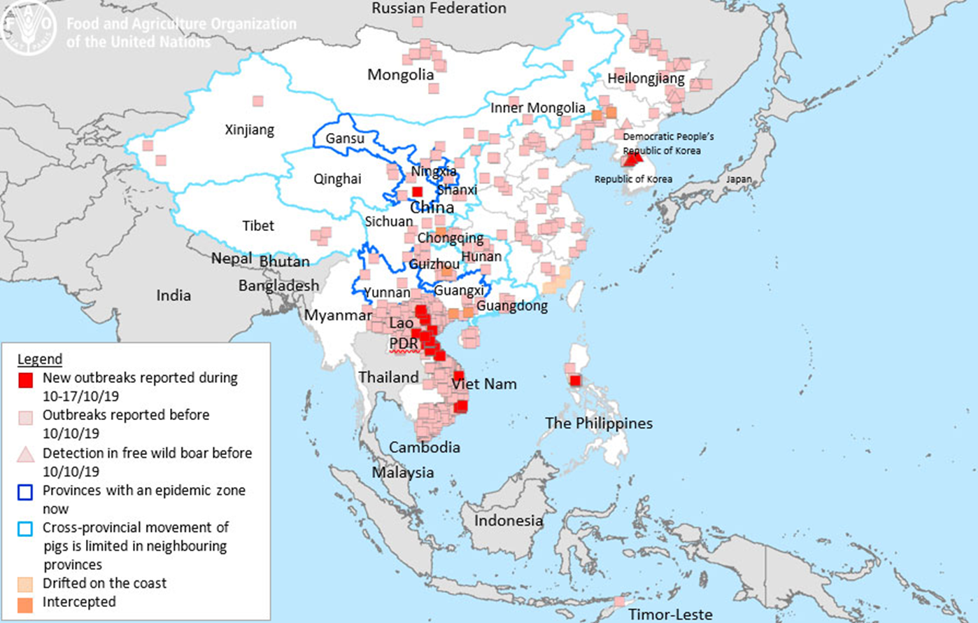
Industry Outlook 2019

Slide 27
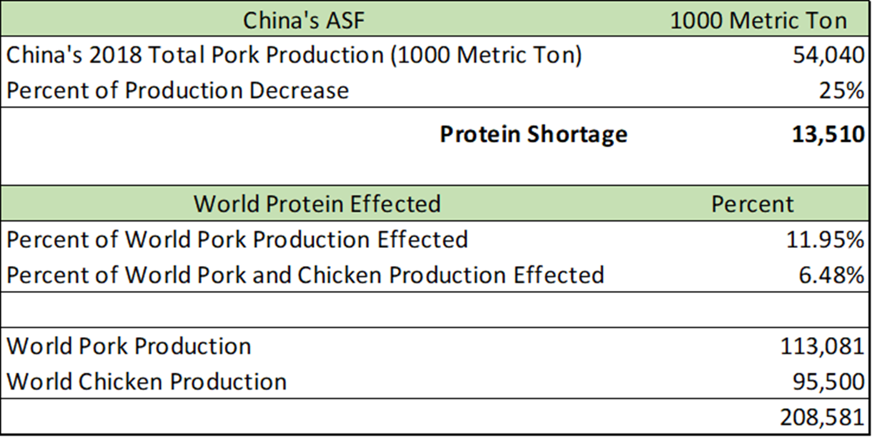
Industry Outlook 2019

Slide 28
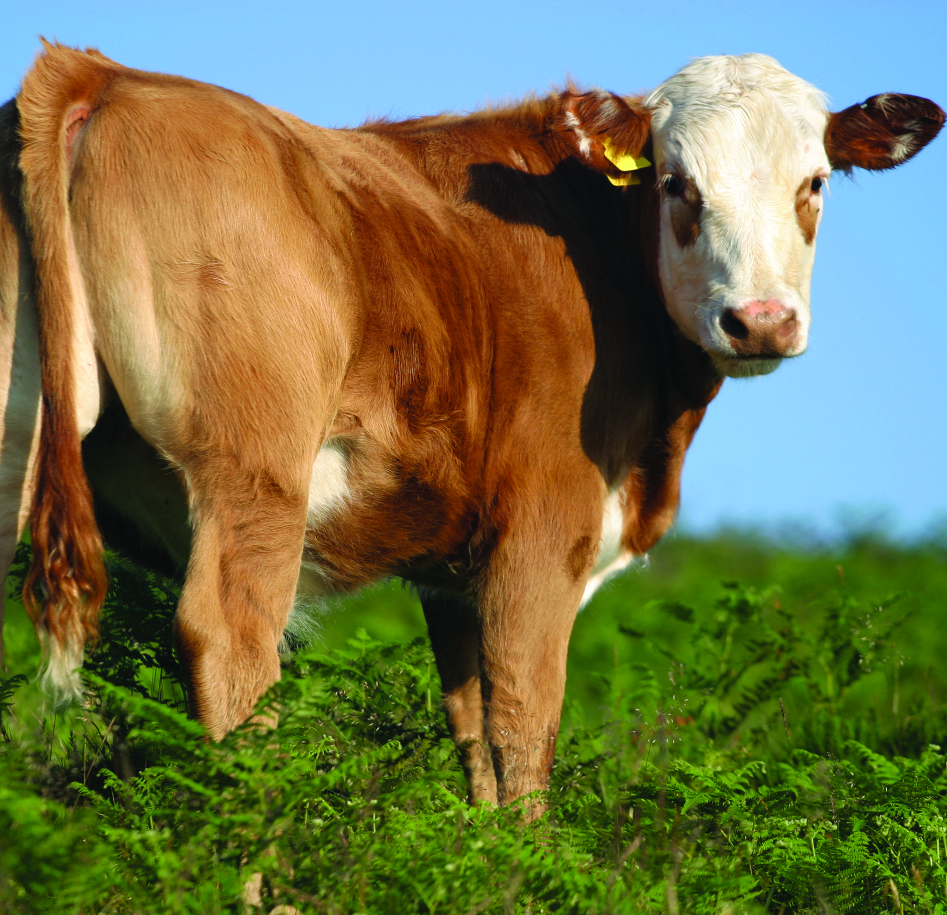
Industry Outlook 2019
Cow/Calf
Stability in Canada
Herd growth plateaued
Slow start to fall run
  Ample forage and feed grain
Consumer preferences
Safe Guards
Perform walk-through on short notice
Verify inventory and require manifests and/or proof of purchase or sale. Look closely at inventory values.
Verify AgriStability and risk management practices.

Slide 29
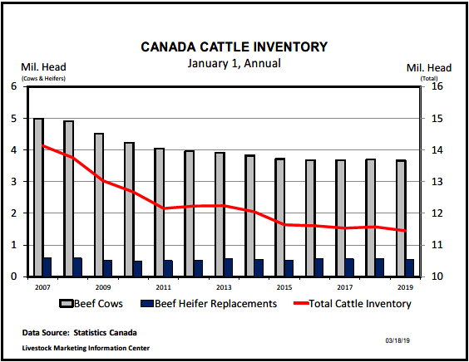
Industry Outlook 2019

Slide 30
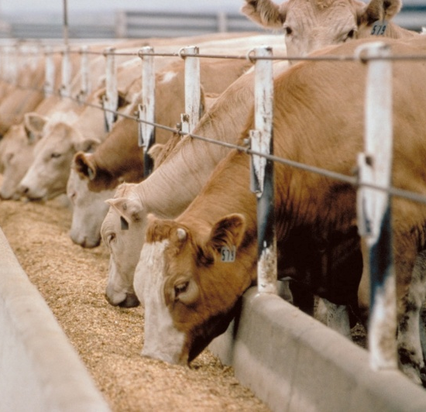
Industry Outlook 2019
Feedlots
Higher prices due to kill plant fire
  Tyson plant in Holcomb, KS (5% of US slaughter)
Pen space at premium
Feed prices trending down
Risk management strategy still key
Safe Guards
Verify inventory and require manifests and/or proof of
purchase or sale
Verify AgriStability status and CPIP contracts
Ensure lands properly captured in loan documents and
registered at land titles
Check risk management practices. Scrutinize business plans.

Slide 31

Industry Outlook 2019
Wineries
Agritourism
Demand for quality vineyard property strong
  Controlling productive assets long term
Exports
Safe Guards
Verify Inventory (and value in-use).- sample to ensure quality.
Confirm terms of licences to produce and sell are being met.
Seek rolling 5 year plans/third-party input – primary downfall is cash and
inventory management.

Slide 32
Industry Outlook 2019
Source: Statistics Canada

Slide 33
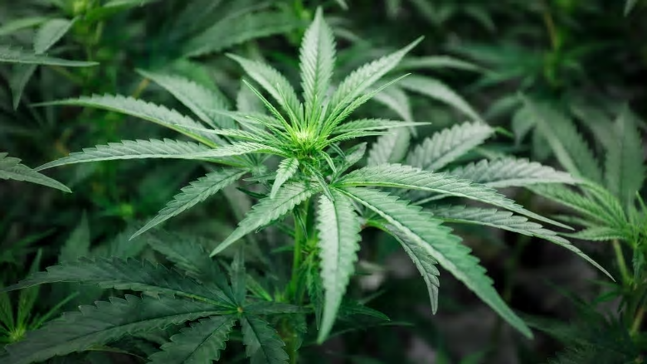
Industry Outlook 2019
Cannabis
Sluggish retail sales
Commoditization
Joint Ventures with Food and Beverage
Safe Guards
Ensure all property of creditor included on debt security.
Confirm terms of licences to produce and sell are being met.
Confirm key individuals named in licences are tied to the company.

Slide 34

Industry Outlook 2019
Food and Beverage
Margins are getting squeezed
  Look to reduce Energy, Water, Waste
Food Safety
Access to labour/automation
Safe Guards
Ensure all property of creditor included on debt security.
Confirm terms of licences to produce and sell are being met.
Confirm key individuals named in licences are tied to the company.

Slide 35
Contacts
Farm Management Consulting
John Loeppky , P. Ag
Direct: 204.336.6148 Cell: 204.381.3260
john.loeppky@mnp.ca
Corporate Recovery Services
Victor Kroeger, CPA,CA,LIT,CIRP, CFE
Direct: 403.298.8479 Cell: 403.870.1827
vic.kroeger@mnp.ca

Slide 36
Appendices – Our People
The MNP Advantage:
Offices in strategic urban and rural locations from coast-to-coast
Experience with 15,000 commercial and approximately 300 Hutterite Brethren clients
For more than 60 years, MNP has represented the interests of our clients and the Canadian agriculture industry in provincial and federal matters.
Nobody does it better.

Slide 37
Appendices – Our People
The MNP Advantage:
Offices in strategic urban and rural locations from coast-to-coast
Experience with 15,000 commercial and approximately 300 Hutterite Brethren clients
For more than 60 years, MNP has represented the interests of our clients and the Canadian agriculture industry in provincial and federal matters.
Nobody does it better.

Slide 38
Appendices – Our People
Over 600 professionals focused on the agriculture industry with niche specialities in:
  Farm Management Consulting
  Crops
  Livestock
  Agriculture Risk Management Resources (ARMR)
    Ag Risk Management Projector (ARMP)
    AgriStability
    AgriInvest
    GARS
    JustSolutions
  Industry-specific financial reporting methods & tax specialists
  Food & Ag Processing
  Hutterian Brethren
  Succession Planning with MNP’s TransitionSMART

Slide 39
Appendices – Our People
Agriculture Risk Management Resources (ARMR)
One of the key considerations for any farm operator is risk management. With multiple risks to consider and various insurance programs to cover them, it can be overwhelming for clients to determine the best course of action regarding their farm’s risk management strategies. MNP’s Agriculture Risk Management Resources (ARMR) provides our clients with critical information so that they can grow their business while protecting and safeguarding it during challenging times. With ARMR and MNP’s Ag Risk Management Projector™, we help our clients understand and evaluate the best options for them, their business and their peace of mind.
MNP’s team of specialists draw on extensive research. They have long-term relationships with various levels of government and take a comprehensive approach to help our clients get the most from their risk management strategies.

Slide 40
Appendices – Our People
Our FMC team is made up of professional agrologists and consultants who come from extensive agriculture backgrounds, bringing a high level of technical expertise, firsthand knowledge and close relationships with the agriculture industry to every engagement.
Education and experience include:
Bachelors of Science in Agriculture (B. Sc.)
Professional Agrologists (P. Ag)
Certified Agricultural Consultants (CAC)
Former and current farm managers and producers

Slide 41
Appendices – Our People
Within the Farm Management Consulting team we have niche professionals in:
  Crop production and marketing (dryland and irrigated)
  Intensive livestock production and marketing
  Supply managed (dairy and poultry)
  Commodity and food processing
  Exotics
  Greenhouse and Market Gardening
  Orchard Fruit

Slide 42
Appendices – Special Situations
Working closely with Corporate Recovery Services, the Farm Management Consulting team have assisted with the provision of:
  Initial assessment of a debtor
  Monitoring
  Restructuring
  Liquidation

Slide 43
Appendices – Special Situations
The Farm Management Consulting team has provided the following services to Corporate Recovery Engagements:
  Assisting with taking possession of farm operations
  Determining and executing strategies for ongoing operations
  Providing executive management of day-to-day farm operations
  Consulting on key decision points in farm operations
  Preparation of risk analysis and mitigation strategies
  Providing input into realization plans

